Slide 1
Module 5: Network Management Security and Network Access Control
-by Asst Prof Rohini M. Sawant

Slide 2
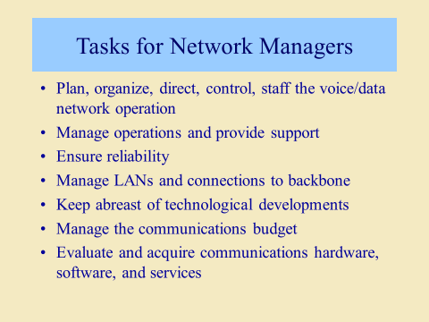

Slide 3
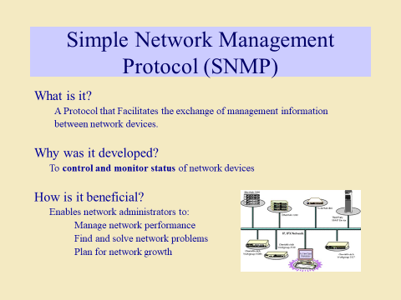

Slide 4
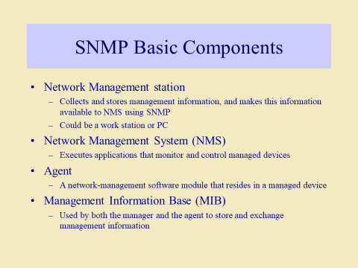
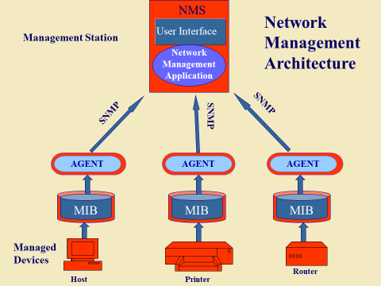

Slide 5
SNMP Components
Managers & Agents:
A manager is a host that runs the SNMP client program while the agent is a router that runs the SNMP server program.
Management of the internet is achieved through simple interaction between a manager and agent.
The agent is used to keep the information in a database while the manager is used to access the values in the database. For example, a router can store the appropriate variables such as a number of packets received and forwarded while the manager can compare these variables to determine whether the router is congested or not.
Agents can also contribute to the management process. A server program on the agent checks the environment, if something goes wrong, the agent sends a warning message to the manager.

Slide 6
SNMP Components
Management Components
Management is not achieved only through the SNMP protocol but also the use of other protocols that can cooperate with the SNMP protocol. Management is achieved through the use of the other two protocols: SMI (Structure of management information) and MIB(management information base).
SMI: The SMI (Structure of management information) is a component used in network management. Its main function is to define the type of data that can be stored in an object and to show how to encode the data for the transmission over a network.

Slide 7
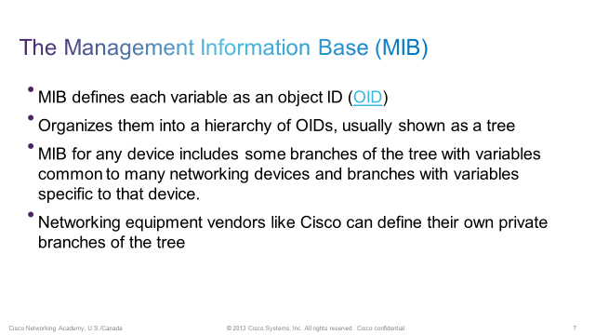
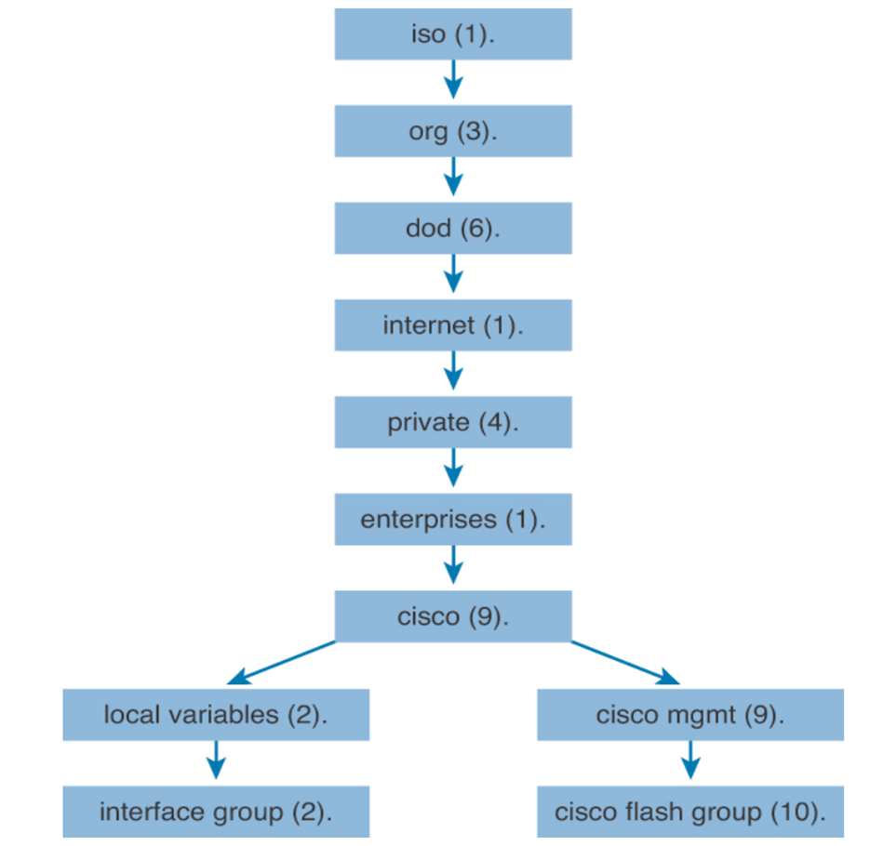
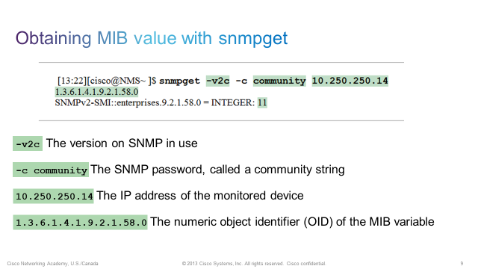

Slide 8
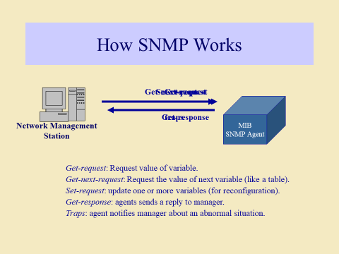

Slide 9
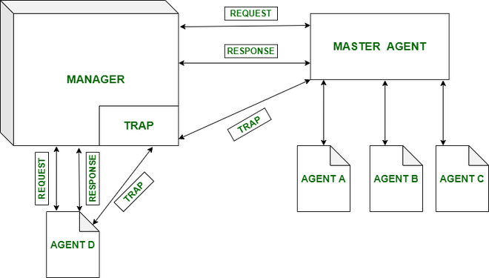

Slide 10
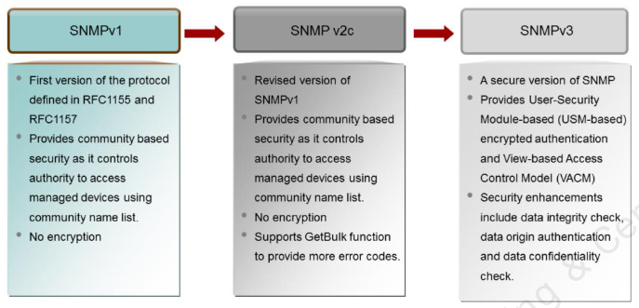
SNMP Versions
SNMP v3 features:
•Message integrity: This helps ensure that a packet has not been tampered with in transit
•Authentication: This helps ensure that the packet came from a known and trusted source
•Encryption: This helps to ensure that information cannot be read if the data is captured in transit

Slide 11
SNMP V3
The security features provided in SNMPv3 are as follows:
Message integrity—Ensures that a packet has not been tampered with during transit.
Authentication—Determines that the message is from a valid source.
Encryption—Scrambles the content of a packet to prevent it from being learned by an unauthorized source.
v3 is the latest version of SNMP which involves great management services with enhanced security.
The SNMPv3 architecture makes the use of User-based Security Model (USM) for security of the messages & the View-based Access Control Model (VACM) for accessing the control over the services.
SNMP v3 security models supports authentication and encrypting.
SNMPv3 supports Engine ID Identifier, which uniquely identifies each SNMP identity. The Engine ID is used to generate a unique key for authenticating messages.
v3 provides secure access to the devices that send traps by authenticating users & encrypting data packets which are sent across the network.
It also introduces the ability to configure and modify the SNMP agent using SET for the MIB objects. These commands enable deletion, modification, configuration and addition of these entries remotely.

Slide 12
SNMP V3
Mechanism Support of version 3 :
16-byte key between sender & receiver
Triple Data Encryption Standard
Advanced Encryption Standard
Data Encryption Standard (DES) in Cipher Block Chaining (CBC) mode
MD5 message-digest algorithm

Slide 13
NETWORK ACCESS CONTROL (NAC)
Network access control, or NAC solutions support network visibility and access management through policy enforcement on devices and users of corporate networks.
With organizations now having to account for exponential growth of mobile devices accessing their networks and the security risks they bring, it is critical to have the tools that provide the visibility, access control, and compliance capabilities that are required to strengthen your network security infrastructure.
A NAC system can deny network access to noncompliant devices, place them in a quarantined area, or give them only restricted access to computing resources, thus keeping insecure nodes from infecting the network.
Network access control (NAC) is an umbrella term for managing access to a network. NAC authenticates users logging into the network and determines what data they can access and actions they can perform.
NAC also examines the health of the user’s computer or mobile device (the endpoints).

Slide 14
ELEMENTS OF NETWORK ACCESS CONTROL (NAC)
NAC systems deal with three categories of components:
■ Access requestor (AR): The AR is the node that is attempting to access the network and may be any device that is managed by the NAC system, including workstations, servers, printers, cameras, and other IP-enabled devices. ARs are also referred to as supplicants, or simply, clients.
■ Policy server: Based on the AR’s posture and an enterprise’s defined policy, the policy server determines what access should be granted. The policy server often relies on backend systems, including antivirus, patch management, or a user directory, to help determine the host’s condition.
■ Network access server (NAS): The NAS functions as an access control point for users in remote locations connecting to an enterprise’s internal network. Also called a media gateway, a remote access server (RAS), or a policy server, an NAS may include its own authentication services or rely on a separate authentication service from the policy server.

Slide 15
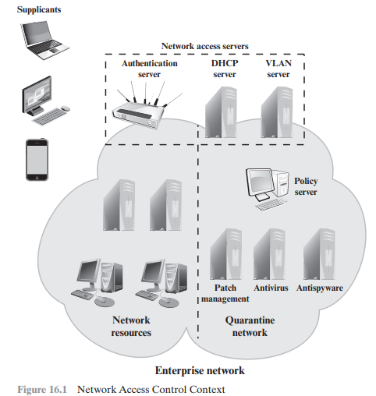

Slide 16
NETWORK ACCESS CONTROL (NAC)
A variety of different ARs seek access to an enterprise network by applying to some type of NAS. The first step is generally to authenticate the AR. Authentication typically involves some sort of secure protocol and the use of cryptographic keys. Authentication may be performed by the NAS, or the NAS may mediate the authentication process. In the latter case, authentication takes place between the supplicant and an authentication server that is part of the policy server or that is accessed by the policy server.
The authentication process serves a number of purposes. It verifies a supplicant’s claimed identity, which enables the policy server to determine what access privileges, if any, the AR may have. The authentication exchange may result in the establishment of session keys to enable future secure communication between the supplicant and resources on the enterprise network.
These checks—sometimes called health, suitability, screening, or assessment checks—require software on the user’s system to verify compliance with certain requirements from the organization’s secure configuration baseline. For example, the user’s antimalware software must be up-to-date, the operating system must be fully patched, and the remote computer must be owned and controlled by the organization.
These checks should be performed before granting the AR access to the enterprise network.. Based on the results of these checks, the organization can determine whether the remote computer should be permitted to use interactive remote access.

Slide 17
NETWORK ACCESS CONTROL (NAC)
Once an AR has been authenticated and cleared for a certain level of access to the enterprise network, the NAS can enable the AR to interact with resources in the enterprise network. The NAS may mediate every exchange to enforce a security policy for this AR, or may use other methods to limit the privileges of the AR.

Slide 18
NAC ENFORCEMENT METHODS
Enforcement methods are the actions that are applied to ARs to regulate access to the enterprise network. Many vendors support multiple enforcement methods simultaneously, allowing the customer to tailor the configuration by using one or a combination of methods. The following are common NAC enforcement methods.
■ IEEE 802.1X: This is a link layer protocol that enforces authorization before a port is assigned an IP address. IEEE 802.1X makes use of the Extensible Authentication Protocol for the authentication process..
■ Virtual local area networks (VLANs): In this approach, the enterprise network, consisting of an interconnected set of LANs, is segmented logically into a number of virtual LANs.1 The NAC system decides to which of the network’s VLANs it will direct an AR, based on whether the device needs security remediation, Internet access only, or some level of network access to enterprise resources. VLANs can be created dynamically and VLAN membership, of both enterprise servers and ARs, may overlap. That is, an enterprise server or an AR may belong to more than one VLAN.

Slide 19
NAC ENFORCEMENT METHODS
■ Firewall: A firewall provides a form of NAC by allowing or denying network traffic between an enterprise host and an external user.
■ DHCP management: The Dynamic Host Configuration Protocol (DHCP) is an Internet protocol that enables dynamic allocation of IP addresses to hosts. A DHCP server intercepts DHCP requests and assigns IP addresses instead. Thus, NAC enforcement occurs at the IP layer based on subnet and IP assignment. A DCHP server is easy to install and configure, but is subject to various forms of IP spoofing, providing limited security.

Slide 20
HOW TO IMPLEMENT NAC SOLUTIONS
Gather data- If you’re going to restrict how your users access the network, you’ll first need to understand how they’re using it. Who’s connecting to what, and from which devices? Is there a business requirement behind their current level of access? Don’t forget to consider servers, printers, phones, IoT devices, and anything else connected to the network.
Catch up on identity management- If like most organizations, you plan on including an authentication component in your NAC policy, you’ll need to make sure you’re on top of identity management. If a new hire can’t get online because your active directory servers aren’t syncing with an HR database, then that shiny new NAC solution might wind up costing the company more money than it’s worth. On the other hand, NAC security won’t help you if you never bothered to de-provision an employee who left the company six months ago.
3. Determine permissions and access levels- It's up to you to decide how to apply the capabilities of your NAC solution. Ideally, you’d implement the purest form of the principle of least privilege and limit all users to the minimum network resources needed to carry out their jobs. However, most large networks simply aren’t segmented enough to strictly adhere to this principle. Implementing role-based access control can be a good middle ground without compromising too much on security.

Slide 21
HOW TO IMPLEMENT NAC SOLUTIONS
Test your setup- Most NAC solutions can be configured in a “monitor” mode, meaning the impact of policies can be measured before actually enforcing them. This is an important step, as it allows you to spot any potential problems before they generate a large volume of support tickets. It’s a good idea to test your NAC policies both before you implement them and as you make changes.
5. Monitor and tune- Network access control is not a “set it and forget it” type of security control. You’ll need to make adjustments as the organization (and the threats facing it) evolve over time. Make sure you have the resources needed to continually monitor and optimize the solution before beginning an NAC implementation journey.

Slide 22
USE CASES FOR NAC
NAC for guests/contractors: Whether accounting for contractors, visitors, or partners, organizations use NAC solutions to make sure that non-employees have access privileges to the network that are separate from those of employees.
NAC for BYOD: The exponential growth in mobile devices has liberated the workforce from their desks and given employees freedom to work remotely from their mobile devices. NAC for BYOD ensures compliance for all employee owned devices before accessing the network.
NAC for the Internet of Things: IoT devices, whether they be in manufacturing, healthcare, or other industries, are growing exponentially and serve as additional entry points for attackers to enter the network. NAC can reduce these risks in IoT devices by applying defined profiling and access policies for various device categories.
NAC for incidence response: NAC vendors can share contextual information (for example, user ID or device type) with third-party security components. They can respond to cybersecurity alerts by automatically enforcing security policies that isolate compromised endpoints.
NAC for medical devices: As more medical devices come online, it’s critical to identify devices entering a converged network. NAC solutions can help protect devices and medical records from threats, improve healthcare security, and strengthen ransomware protection.

